Slide 1
15. Binary Tree, Part 2: Removing BST Tree Nodes; Tree Traversals
ECE 309
Dr. James Tuck

Slide 2
Objectives
Review the algorithmic complexity of search and insertion on binary trees.
Define and identify successor node and predecessor node on a BST.
Describe the requirements for removing a node from a BST.
Identify three cases and derive pseudocode for removing nodes from a BST.
Define and implement an in-order tree traversal.

Slide 3
Time Complexity of Binary Search Tree operations
Operation on N nodes | Time Complexity | Explanation
Search | O(H) or O(log N) | Time complexity is dictated by the height of the tree. A full tree has height, H = log N.
Insert one node | O(H) or O(log N) | Insertion is essentially the same complexity as search, since we search for the place to insert. Placing the node in the tree is just a few pointer updates (O(1)), and doesn’t worsen complexity.
Insert N nodes | O(N * log N) | If we insert N nodes, each insertion costs log N. In total, that’s N * log N.

Slide 4
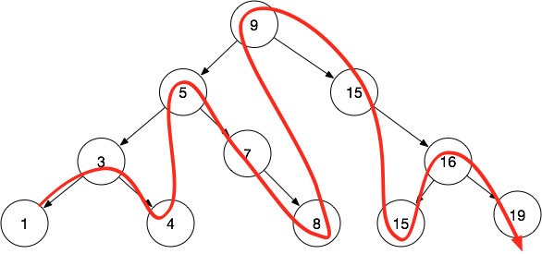
BST ordering of nodes
BSTs define an ordering of nodes from smallest to largest.
Order: 1, 3, 4, 5, 7, 8, 9, 15, 15, 16, 19

Slide 5
BST successors and predecessors
Using that ordering, we define two terms:
A successor node is the next larger node in the BST tree.
A predecessor node is the next smaller node in the BST tree.

Slide 6
Examples
1 is the predecessor of 3
3 is the successor of 1
9 is successor of 8
15 is successor of 15
4 is predecessor of 5

Slide 7
Algorithm for finding a successor
Two cases for finding successor of node, n:
If n has a right child, the successor is the left-most node of n’s right sub-tree
If there is no right child, then n’s successor is an ancestor:
Go up the tree until you find an ancestor, a, such that n falls in its left sub-tree; a is the successor
If no such ancestor exists, n has no successor.

Slide 8
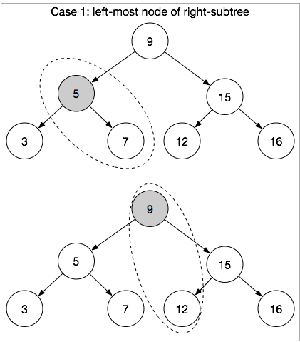
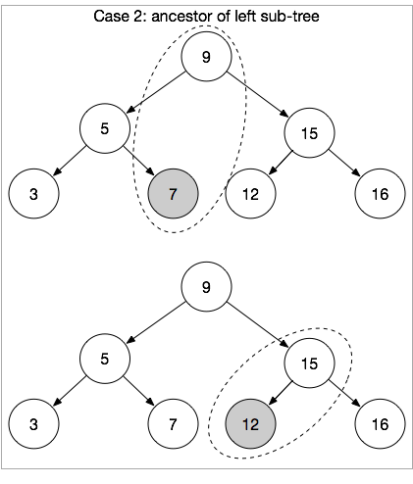
Examples of Case 1 and Case 2

Slide 9
Tips for finding an ancestor
For case 2, if we need to find an ancestor, two ways:
Option 1: Keep a stack of nodes visited as you descend the tree, then pop them off the stack to go back up.
Option 2: Change each node to hold a pointer to its parent, then we can just traverse the parent nodes up the tree
This is analogous to a doubly-linked list and very common
ZyBook 4.8 describes this alternative design
Add BTNode *parent to BTNode.

Slide 10
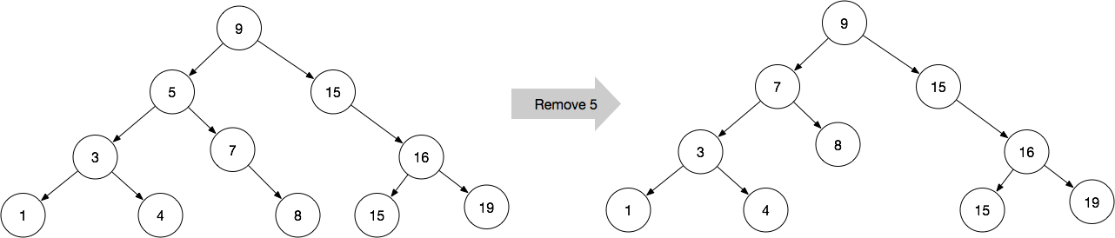
Removing a Node from a BST
When we remove a node from a BST, we must retain the BST property.
Theoretically, we can change the tree however we like during removal as long as it retains all other nodes in BST order.
But, we should try to be efficient and remove with efficiency <= O(log N)

Slide 11
Removing a Node from a BST
Some cases are easy to handle in O(log N):
Case 1 (no children): Remove a leaf
Set edge in parent to null
Case 2 (one child): Internal node with a single child
Set edge in parent to point to child (similar to linked list removal)

Slide 12
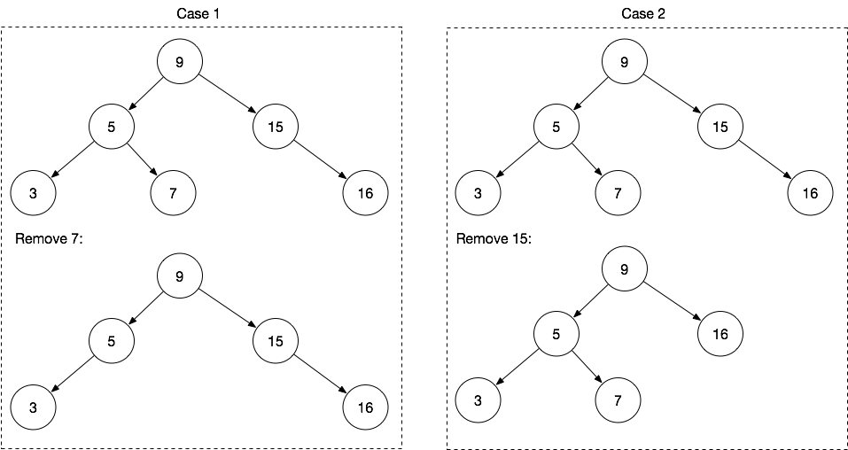
Example of Case 1 and Case 2

Slide 13
Removing a Node from a BST
Case 3: Removing a node with two children
Step 1: find and remove the successor
Step 2: replace the node with the successor
The successor node satisfies all BST ordering constraints:
It’s larger than all nodes in the left sub-tree.
It’s smaller than every other node in the right sub-tree.

Slide 14
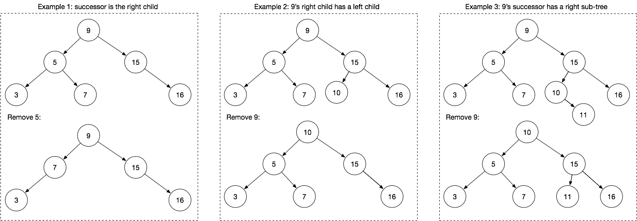
Example of Case 3: node has 2 children

Slide 15
Pseudocode for BSTRemove
void BSTRemove(tree, key) {
node = root; // temporary variable, start at root of tree
parent = NULL; // need the parent node to update links
while (node not null) {
if (node->data == key) {
// FOUND IT! ACTUALLY REMOVE THE NODE
// Handle Case1, Case2, Case3
}
else if (key < node->data) {
parent = node;
node = node->left;
} else {
parent = node;
node = node->right;
}
}
}
Core part of the algorithm is the same BSTSearch.
We add a parent pointer so that we can fix up ancestor’s child pointers as needed.
parent serves a similar purpose as prev pointer in linked list removal.

Slide 16
Pseudocode for Case 1
// Handle leaf node
bool Case1(tree, parent, node) {
if (node->left == NULL and node->right == NULL) { // found a leaf
if (parent==NULL) { // found the root
tree->root = NULL;
} else if (parent->left == node) {
parent->left = NULL;
} else {
parent->right = NULL;
}
return true; // we applied Case 1, we’re done!
}
return false; // not Case 1, try Case 2
}
If node has no children, it’s a leaf node.
But, we have to figure out which side of the parent it’s on so we can set that child to NULL.
Not shown here, we may also need to free node at a later step.

Slide 17
Pseudocode for Case 2
// Handle internal node with 1 child
bool Case2(tree, parent, node) {
if (node->left != NULL and node->right == NULL) { // node has a left child
if (parent==NULL) tree->root = node->left; // node’s child becomes the new root!
else if (parent->left == node) // node is on the left, so child is on the left
parent->left = node->left;
else // on the right!
parent->right = node->left;
return true; // Case 2 applied
} else if(node->left==NULL and node->right != NULL) { // node has a right child
if (parent==NULL) tree->root = node->right; // node’s child becomes the new root
else if (parent->left == node) // node is on the left, so child moves up to the left
parent->left = node->right;
else // else on the right!
parent->right = node->right;
return true; // Case 2 applied
}
return false; // not Case 1 or 2, must use Case 3
}

Slide 18
Pseudocode for Case 3
// Handle node with two children; we don’t check assuming check already happened
void Case3(tree, parent, node) {
succ = node->right; // successor must be in right sub-tree
prev = node
while(succ->left != NULL) { // find left-most node in right sub-tree
prev = succ; // prev will point to the node’s parent
succ = succ->left;
}
// Remove the successor node. It must be a case 1 or case 2 node since it has no left child.
if( !Case1(tree,prev,succ) ) { // Leverage Case1 and Case2 to remove successor properly
Case2(tree,prev,succ);
}
succ->left = node->left;// Now replace node with succ, update left child, right child, and parent
succ->right = node->right;
if (parent==NULL)
tree->root = succ;
else if(parent->left == node)
parent->left = succ;
else parent->right = succ;
}

Slide 19
Pseudocode for BSTRemove
void BSTRemove(tree, key) {
node = root; // temporary variable, start at root of tree
parent = NULL; // need the parent node to update links
while (node not null) {
if (node->data == key) {
if (!Case1(tree,parent,node))
if(!Case2(tree,parent,node))
Case3(tree,parent,node);
Free the node; return;
}
else if (key < node->data) {
parent = node;
node = node->left;
} else {
parent = node;
node = node->right;
}
}
}
We check Case 1 and Case 2 first.
If neither succeed, we use
Case 3.

Slide 20
C++ implementation
As homework, you will implement the BSTRemove algorithm.

Slide 21
Time Complexity of Binary Search Tree operations
Operation on N nodes | Time Complexity | Explanation
Search | O(log N) | Time complexity is dictated by the height of the tree. A full tree has height = log N.
Insert one node | O(log N) | Insertion is essentially the same complexity as search, since we search for the place to insert. Placing the node in the tree is just a few pointer updates (O(1)), and doesn’t worsen complexity.
Insert N nodes | O(N * log N) | If we insert N nodes, each insertion costs log N. In total, that’s N * log N.
Remove 1 node | O(log N) | Removal is also dominated by search, which is O(log N). Case 1 and Case 2 are clearly log N. Case 3 involves two searches. But, it can be seen as a search for the node, followed by a search for the successor. Both are bounded by H. Hence, still log N.

Slide 22
Tree Traversal
A tree traversal visits each node of the tree once and performs an action.
The action may be as simple as printing the contents.
An in-order traversal recursively visits the left sub-tree, the node, the right sub-tree.
For a BST, an in-order traversal matches BST order.

Slide 23
Inorder traversal pseudocode
PrintInorder(node):
if (node is NULL) // base case, stop if null
return
PrintInorder(node->left) //recursively print left side
print node //print the node
PrintInorder(node->right)//recursively print right side

Slide 24
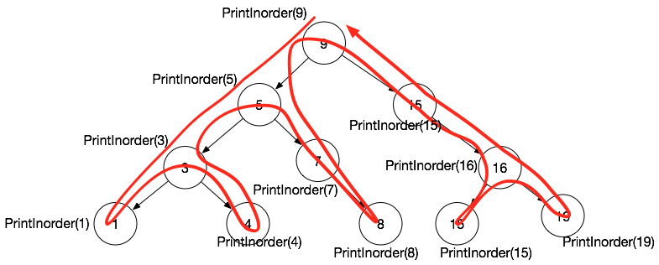
Inorder traversal example
Follow the arrow through the Inorder function calls:
PrintInorder(9)
PrintInorder(5)
PrintInorder(3)
PrintInorder(1) - print 1
print 3
PrintInorder(4) - print 4
print 5
PrintInorder(7)
print 7
PrintInorder(8) - print 8
print 9
PrintInorder(15)
print 15
PrintInorder(16)
PrintInorder(15) - print 15
print 16
PrintInorder(19) - print 19

Slide 25
Inorder Traversal in C++
// protected member function
void BinarySearchTree::printInorderHelper(BTNode *node)
{
if(node==NULL) return; // base case, stop at NULL nodes
printInorderHelper(node->left);
printf(“%d “,node->data);
printInorderHelper(node->right);
}
// public member function
void BinarySearchTree::printInorder() {
// root is hidden, so we need a helper function to kick off the traversal
printInorderHelper(root);
}

Slide 26
Time Complexity of Binary Search Tree operations
Operation on N nodes | Time Complexity | Explanation
Search | O(log N) | Time complexity is dictated by the height of the tree. A full tree has height = log N.
Insert one node | O(log N) | Insertion is essentially the same complexity as search, since we search for the place to insert.
Insert N nodes | O(N * log N) | If we insert N nodes, each insertion costs log N. In total, that’s N * log N.
Remove 1 node | O(log N) | Case 1 and Case 2 are searches, so log N. Case 3 involves two searches of log N, hence still log N.
In-order Traversal | O(N) | We visit each node once. What about the additional operations to traverse the tree’s edges? The number edges is approximately N. Hence, O(N+N) = O(N).

Slide 27
Summary
Search, insertion, removal are O(log N) and traversal of all items is O(N).
Removal of a BST node involves three key cases: removing a leaf node, removing an internal node with one child, and removing a node with two children.
Removing a node with two children requires first removing the node’s successor and then replacing the node with its successor.
In-order traversal is one way to print out the nodes of a BST in order.

Slide 28
References
1. ZyBook on Data Structures, chapters 15.1, 15.5, 15.6

